Slide 1

Title: MUMScheduler
SWE PROJECT
Instructor :
Mr. Obinna Kalu
Presented by :
Ayoub Lachhab
Filmon Tesfalem
Zebib Zegherghish
Helen Teklemariam
Anderson Arbelaez Arias

Slide 2
Plan
I. Use Case Diagram
III. System Architecture
IV. Key Abstraction
VI. VOPS Diagram
VII. Method of working
V. Sequence Diagram
II Use Case Description

Slide 3
Use case digaram

Slide 4

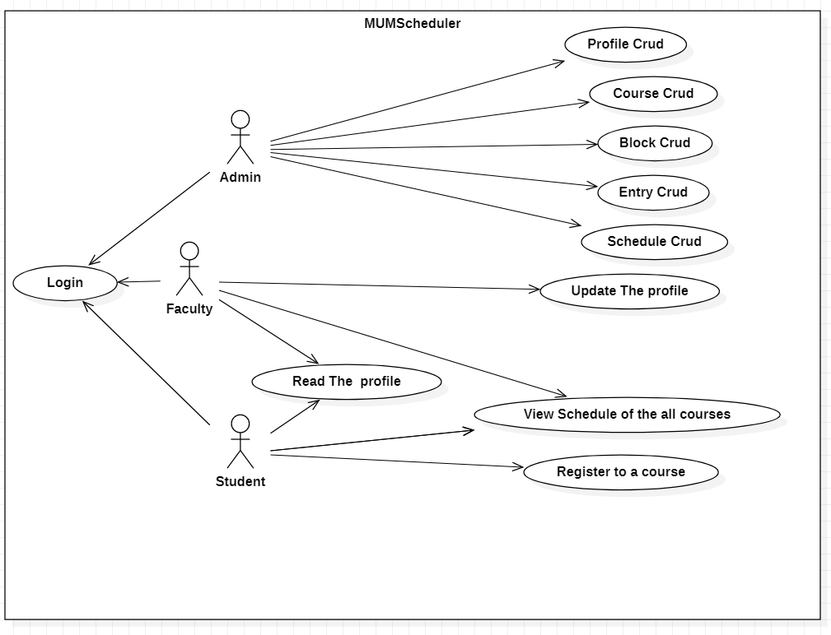

Slide 5
Use case Description

Slide 6
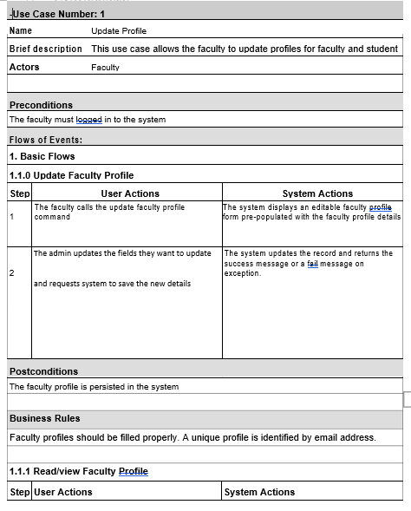

Slide 7
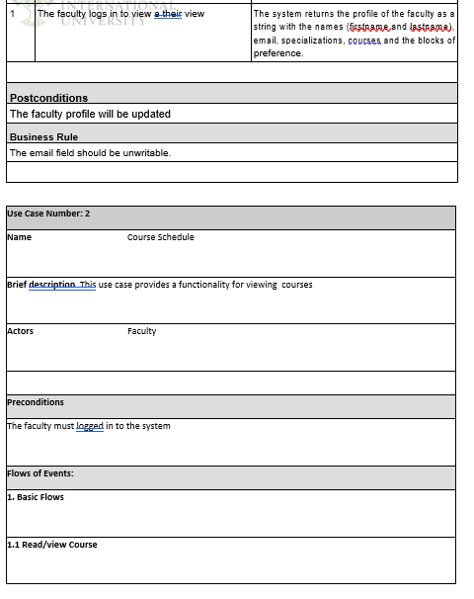

Slide 8
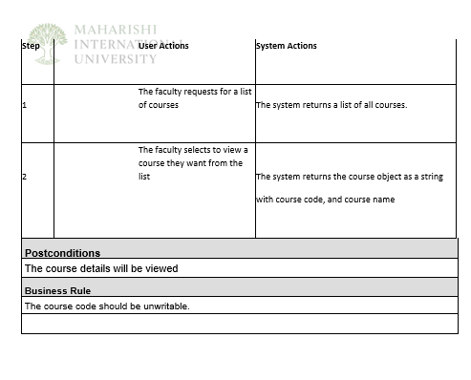

Slide 9
System architecture

Slide 10
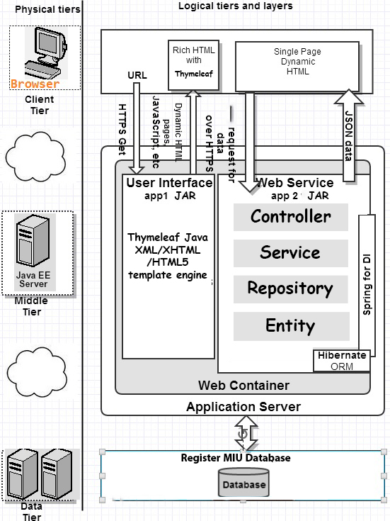

Slide 11
Key Abstraction

Slide 12
Course
Professor
Student
Faculty
Semester
Block
Entry
Schedule

Slide 13
Sequence Diagrams

Slide 14
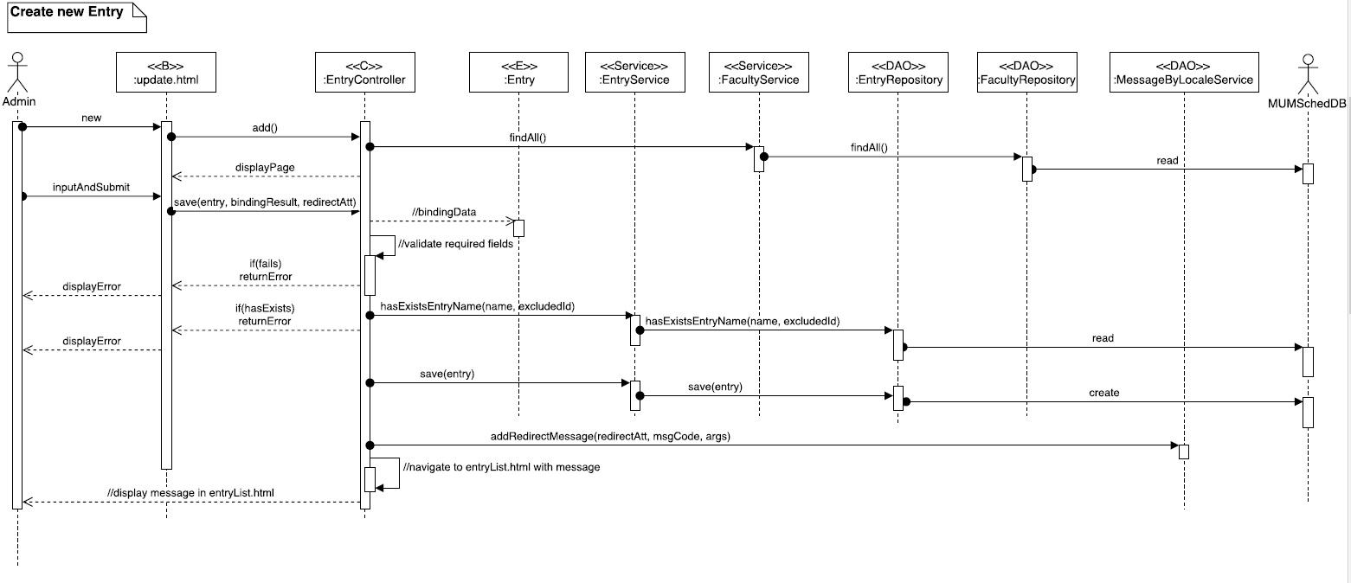

Slide 15
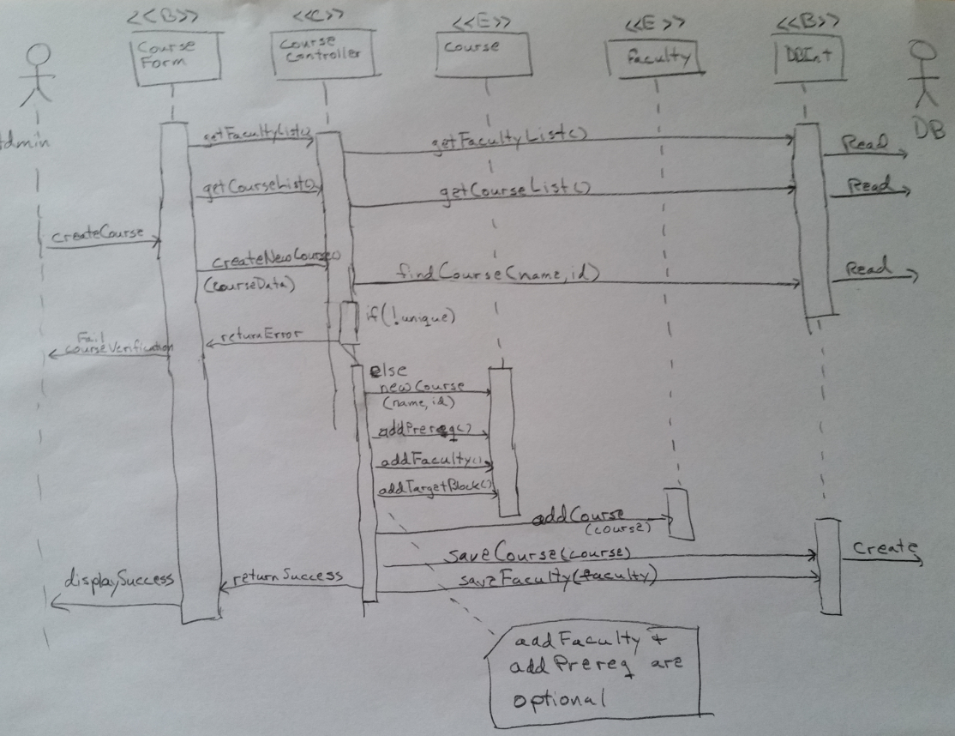

Slide 16
VOPS Diagrams

Slide 17
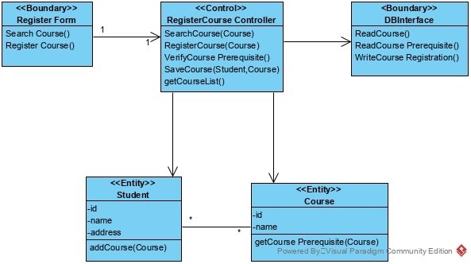

Slide 18
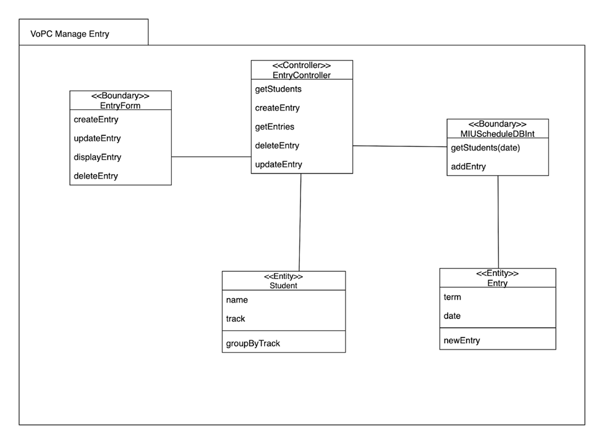

Slide 19


Method of coding in team

Slide 20
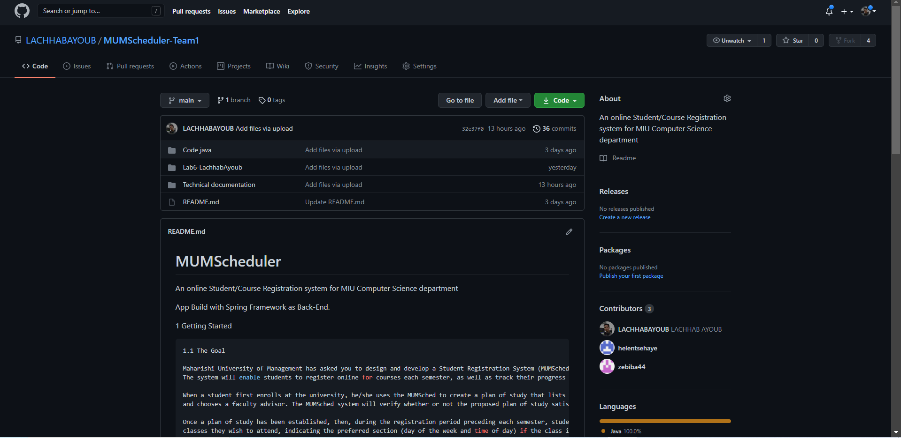

Slide 21


